Slide 1
VFW Department of Missouri Post Service Officer Training
State Convention 2024

Slide 2
Post Service Officer Introduction
The Post Service Officer Program was started in order to reach as many veterans and family members as possible to provide them information about any benefits available in their community. To assist veterans and their family members who would not know where to begin or that are unaware of possible benefits available to them. With your efforts we have been able to assist thousands of veterans to obtain VA benefits.
As a VFW Post Service officer, you are our first line of contact with veterans and their families. Therefore, it is very important that you understand your duties as a Post Service Officer.

Slide 3
What is a Post Service Officer
PSOs are local ambassadors of the Veterans of Foreign Wars; each VFW Post has an appointed PSO.
PSOs must be well versed on state and local benefits.
PSOs are familiar with community programs available to veterans and their families such as local food pantries, VA Facilities, homeless shelters, Accredited Service Officers, etc.

Slide 4
What is expected of a Missouri VFW Post Service Officer
Must attend annual post service officer training at the Missouri VFW State Convention.
Provide information to veterans and family members referencing the Post Service Officers Guide.
Provide veterans and survivors basic knowledge about VA benefits.
Refer veterans and family members to an Accredited VFW Service Office for assistance with ALL VA benefits.
Advise veterans to submit all forms to an Accredited VFW Representative for completion.
Keep Post/Members and survivors aware of events, news, and information relevant to local, state, and federal veteran services and benefits.

Slide 5
Representation
Post Service Officers (PSOs) are local advocates who assist veterans and their loved ones in navigating a complicated benefits landscape. Post Service Officers serve as a conduit to critical programs and services in the community, but they are not accredited by the Department of Veterans Affairs for the purposes of representing claimants in their benefit claims before VA.
Therefore, PSOs DO NOT hold legal standing to represent claimants in their benefit claims before the Department of Veterans Affairs. This distinction is reserved for individuals accredited by VA through the Veterans of Foreign Wars of the U.S. in accordance with Title 38 U.S.C. § 5902 - Recognition of representatives of organizations and the VFW National Veterans Service Policy & Procedure.

Slide 6
Representation – Why is Accreditation Important?
VA accreditation allows organizations and/or individuals the authority to represent veterans before the Department of Veterans Affairs – if you are not accredited, VA will not disclose any information to you about other veterans.
All Department Service Officers, Assistant Veteran Service Officers, & Claims Consultants that work for the VFW are accredited.
Accredited individuals are professional advocates that have completed extensive training in veteran’s benefits and have access to resources that non-accredited individuals do not.
There are many non-accredited organizations who engage in predatory practices.

Slide 7
Representation – Why is Accreditation Important? continued
Many unaccredited individuals and unrecognized organizations advertise online, and some may contact veterans directly to solicit their services.
Many times, they are illegally charging for services and may lack the qualifications required for VA accreditation.
Non-accredited persons often provide mis-information or false hoods that most times will negatively affect the outcome of a claim.
PSOs are not accredited and therefore PSOs ARE NOT insured or covered by their Department or NVS. This means PSOs can personally be held financially responsible for any lawsuits brought against them for misrepresentation or misfiled claims for VA benefits.

Slide 8
VFW Accredited Representatives
The VFW has many types of accredited representatives (VSOs). There is the Department Service Officer (DSO), which is responsible for the Service Officer Program, Assistant Veteran Service Officers (AVSO), and Claims Consultants.
Myth: The DSO, AVSO, and Claims Consultant all have their own unique roles and responsibilities
Fact: The DSO has their own unique role and responsibilities however, the roles and responsibilities of the AVSOs and Claims Consultants are the same.
When it comes to claims work, either the person is accredited or not –title doesn’t matter.
Every accredited representative goes through the same extensive training under the guidance of their Department and NVS.

Slide 9
VSOs and PSOs
Myth: VSOs are authorized to give claim status updates to Post Service officers.
Fact: VSOs are not authorized to give claim status updates to Post Service Officers unless the veteran is with the Post Service Officer and written permission from the veteran naming the individual PSO as a person who can receive information, is on record with the VSO.
Example: Simply writing Post 3245 PSO is not good enough – it must have the PSO’s name and is non-transferrable.
At no time is an accredited representative allowed to release any financial information or discuss a rating with a PSO.
At no time can a PSO tell an accredited representative to file a claim or an appeal on behalf of another veteran.

Slide 10
Representation - General
Under no circumstances is a fee or compensation of any nature to be charged to anyone for service rendered in connection with any claim for which the VFW provides representation.
Membership in the VFW is not required for representation.
The VFW may represent any veteran other than those with a Dishonorable Discharge.
If a veteran has both a dishonorable discharge and an honorable period of service, we may still be able to represent them – refer these veterans to your local Accredited VFW Representative

Slide 11
Representation – How to Know if Someone is Accredited
A searchable list of accredited representatives, agents, and attorneys is available at the VA Office of General Council’s website:
http://www.va.gov/ogc/apps/accreditation/index.asp

Slide 12
MISSOURI VFW ACCREDITED SERVICE OFFICERS

Slide 13
Referral Forms
How to refer a veteran or family member to an Accredited VFW Service Office:
Fill out a Referral Form
DD214 or equivalent
Fax or email all the above-mentioned forms to the VFW St. Louis Regional Office:
Fax: (314)253-4162
Email: vfw.vbastl@va.gov

Slide 14
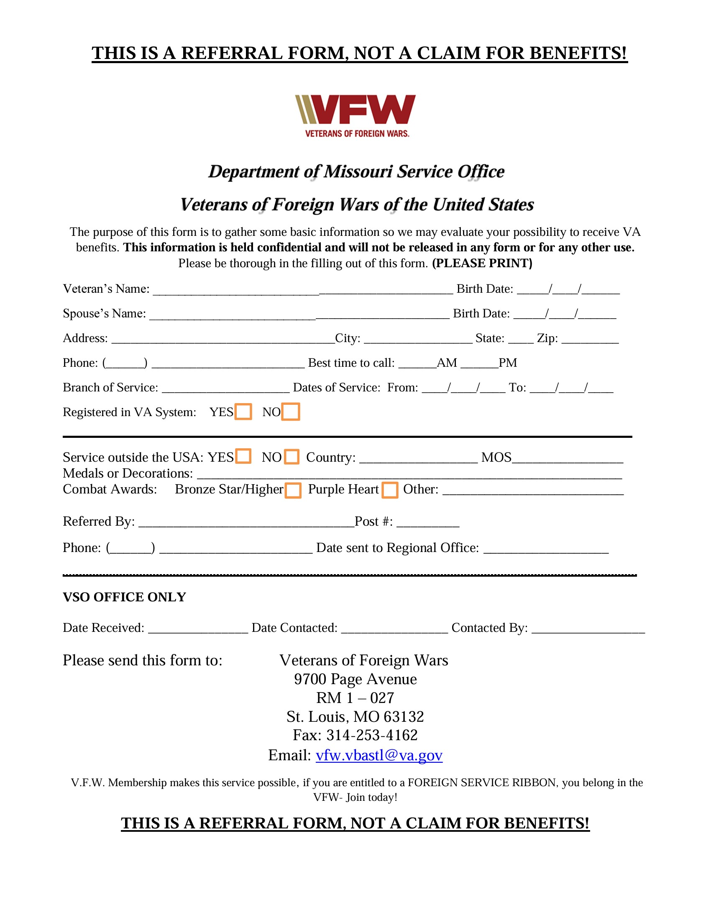

Slide 15
Referral Form QR Code

Slide 16
QR Code Referral Form instructions
Use your smart phone to scan the QR code with your camera.
If you do not have Adobe Acrobat on your device, you will have to email the form to yourself to use the fillable feature or print it out.
If you do have Adobe Acrobat on your device, you can open and auto fill the referral.
Once completed, email to vfw.vbastl@va.gov or fax to (314) 253-4162
The VFW webmaster is trying to convert the QR Code to a fillable format and will update it as soon as its completed.

Slide 17
Code of Conduct for Missouri PSOs
Will perform their duties under the general supervision of the Department Service Officer.
Will not take possession of or release confidential information (Personally Identifiable Information, or PII), such as what conditions were claimed or the address of the claimant, to anyone other than the VFW Accredited Service Officer without the express written consent of the claimant.
Will provide guidance and assistance to veterans and survivors free of charge; under no circumstances, shall they request, demand or accept cash or any other form of payment for such assistance or use their knowledge of a veteran’s claim status or compensation to solicit funds.

Slide 18
Code of Conduct for Missouri PSOs continued
May serve as a “scribe” to assist veterans in filling out prescribed forms and other paperwork for the veteran to immediately transmit directly to the proper accredited VFW representative.
Shall not fill out forms on behalf of a claimant or act as the representative of the claimant before VA or be signing/submitting forms on the claimant’s behalf. These are representative functions reserved for VFW accredited representatives(VSOs), in accordance with VA laws and regulations.
Shall not under any circumstances present themselves as accredited representatives for the purposes of claims representation before the Department of Veterans Affairs on behalf of the VFW.
Notes:
Missouri VFW VSOs and Claims Consultants complete as much as possible on VA forms before sending them to the veteran or claimant. If a blank form is brought to you do not attempt to fill it out, have the veteran or claimant call one of our Service offices.
Examples for scribe: Dependency forms

Slide 19
Code of Conduct for Missouri PSOs continued
Shall return all claims forms, documents, and protected health and personal information to potential claimants so that the claimant may transmit the claim and documents to the accredited VFW representative, Since VA awards benefits based on the date of claim, it is vital to advise claimants that claims should be sent to the VFW accredited representative immediately.
Will not keep any forms, documents, evidence, records, or materials of any kind pertaining to the veteran’s claims and containing PII of the claimant.

Slide 20
Code of Conduct for Missouri PSOs continued
Will attend all Post Service Officer training conducted by the VFW Department Service Officer. While the Department Service Officer is responsible for providing training to the Post Service Officers, the District Service Officer is responsible for ensuring that their Post Service Officers attend training.
Shall not under any circumstances represent themselves as “certified VFW Service Officers” or any variation thereof that implies they are legally qualified to assist and represent claimants in their VA benefit claims. This distinction is reserved for VFW representatives accredited by the Department of Veterans Affairs for prosecution of benefits claims before VA and can only be approved by the Director, VFW National Veterans Service in accordance with the VFW National Veterans Service Policy & Procedure.

Slide 21
Code of Conduct for PSOs continued
Shall not refuse to assist any veteran or survivor unless it is clear the claim is fraudulent. Shall not refuse to assist any veteran or survivor because they do not feel the veteran or survivor is eligible for the benefit sought. The accredited Department Service Officer will make the final decision as to whether the VFW will provide representation in all cases.
Will refrain from the use of racial, religious, age-related, sexual, or ethnic epithets, innuendoes, slurs or jokes in the workplace.
Must conduct themselves in a totally professional manner and refrain from sexual advances, verbal or physical conduct of a sexual nature, or requests for sexual favors.
Further requirements are listed in the VFW National Veterans Service Policy & Procedure, which can be found on www.vfw.org/NVS.

Slide 22
What a Post Service Officer should NOT do
DO NOT under any circumstances file any claims for VA benefits!
Shall not under any circumstances present themselves as accredited representatives for the purposes of claims representation before the Department of Veterans Affairs on behalf of the VFW.
Do not keep any type of Personal Identifiable Information on any veteran or claimant under any circumstance.
Never submit any documentation, forms, or evidence directly to VA on behalf of a veteran or claimant.
Do not try to counsel or advise a veteran, claimant, or family member on what VA benefits or disabilities he or she are entitled to or should apply for.

Slide 23
What a Post Service Officer should NOT do continued
A Post Service Officer is not a VFW employee and should not being using any type of VFW letterhead to contact veterans, claimants, or family members.
Shall not establish or solicit to establish office hours at VA facilities (not limited, but to include, Regional Benefits Offices, VA hospitals, Community Based Outpatient Clinics, & Vet Centers).
Do not let a veteran, claimant, or family member believe you are filing their claim for VA benefits or that you are their accredited representative.
Do not try to contact the VA or an Accredited VFW Representative and ask for information about a veteran’s claim. Neither the VA nor the VFW is allowed by HIPAA Regulations to discuss a veteran’s claim with anyone but the veteran or claimant.

Slide 24
What a Post Service Officer should NOT do continued
If it is found that any of the above has been conducted by a Post Service Officer, it will be reported to VFW Department of Missouri and the VFW National Veterans Service Office and will likely result in the removal from the Post Service Officer position.

Slide 25
What does all that mean? Do’s
DO:
Provide guidance to claimants and assist them in obtaining state and local benefits using the links provided in this PowerPoint or additional government sites.
Attend VSO events and complete referrals.
Refer claimants to an VFW Accredited Representative for assistance with obtaining VA benefits.
Conduct yourself in a professional manner.
Attend Annual PSO training.

Slide 26
What does all that mean? Don'ts
DON’T:
Identify yourself as an accredited representative
Attempt to represent claimants before the VA in any capacity such as signing forms on behalf of, filing claims, or representing claimants during VA hearings etc.
Request or accept payment or any other form of compensation for the advice/assistance provided
Take possession of or release a claimant's personal information to anyone other than a VFW Accredited Representative or the claimant
Initiate or participate in unprofessional conduct in the workplace or in public view
Refuse service to claimants unless the claim is clearly fraudulent or there is unprofessional conduct by the claimant

Slide 27
VFW Benefits and Resources
VFW National Home for Children- The National Home's community is open to the families of active-duty military personnel, veterans and relatives of VFW and VFW Auxiliary members. The family can be one or both parents with one or more children.
Families may accomplish significant life goals by participating in the program
The National Home offers:
Case Management services
Educational, recreational, and enrichment opportunities
- Community resources and counseling
Free housing and daycare
https://www.vfwnationalhome.org

Slide 28
VFW Benefits and Resources
Unmet Needs Program- provides grants (not loans) and referrals to other organizations to active-duty service members, veterans and their immediate families to assist with basic life needs.
https://www.vfw.org/assistance/financial-grants
Sport Clips Help a Hero Scholarship- Provides service members and veterans with the financial assistance they need to complete their educational goals without incurring excessive student loan debt.
Scholarships of up to $5,000 will be awarded to qualified applicants.
Awarded scholarships are limited to one per family per semester.
1 Student Veteran- offers direct assistance to student veterans who have questions or are experiencing problems accessing their VA benefits.
https://www.vfw.org/assistance/student-veterans-support

Slide 29
VA Benefits and Services
The Department of Veterans Affairs offers a wide variety of benefits and services to veterans and their families including:
Compensation
Pension
Healthcare
Education
Home Loan Guarantee
Life Insurance
Survivors' benefits
Burial benefits
Fact Sheets for many VA benefits can be found at:
https://benefits.va.gov/BENEFITS/factsheets.asp

Slide 30
VA Benefits and Services
Remember, the role of the PSO is to explain available benefits, then refer the veteran to an Accredited VFW Representative for additional information and assistance in obtaining benefits.
Prepare the veteran for the process, DO NOT promise or guess anything
Eligibility doesn’t always equal payment
VA will review the file and request applicable examinations and documentation in order to determine entitlement and potential payment

Slide 31
Eligibility References
Guide for Post Service Officers:
https://www.vfw.org/assistance/va-claims-separation-benefits
https://www.va.gov/disability/eligibility/
https://www.va.gov/health-care/eligibility/
https://www.va.gov/pension/eligibility/
https://www.va.gov/housing-assistance/home-loans/eligibility/

Slide 32
Service-Connected Compensation & Non Service-Connected Pension
Service-Connected Compensation:
A disability that VA determines was caused, incurred, or aggravated by military service.
Non Service-Connected Pension:
A benefit paid to wartime veterans who have limited or no income, and who are age 65 or older, or if under 65, are permanently and totally disabled. (INCOME BASED PROGRAM)

Slide 33
Healthcare
VA provides numerous Health Care Services
Hospital, outpatient medical, dental, pharmacy and prosthetic services
Domiciliary, nursing home and community based residential care

Slide 34
Education Benefits
VA administers education benefits for active-duty troops, veterans, reservists, and qualifying dependents.
Forever GI Bill, Post 9/11 GI Bill, Montgomery GI Bill
MGIB Selected Reserve (Section 1606) for Reservists
Dependents Educational Assistance (Chapter 35) for dependents
Veteran Readiness and Employment (VRE) provides assistance to veterans with service-connected disabilities to prepare for, obtain, and maintain suitable employment.

Slide 35
Survivors’ Benefits
Survivors Pension Program
A benefit paid to a surviving spouse of a wartime veteran who have limited or no income. (INCOME BASED PROGRAM)
Dependency and Indemnity Compensation (DIC)
A flat rate monthly benefit paid to a surviving spouse based on one of the following criteria:
Service-member died on active duty
Veteran died from service-related disabilities, including disabilities that can be proven to be service-related (did not have to be receiving disability compensation before death)
Eligibility could also be established if the veteran was deemed permanently and totally disabled by VA for 10 or more years at the time of death

Slide 36
Burial Benefits
Burial
VA offers certain benefits and services to honor deceased veterans to include burial flags, burial allowance, plot or interment allowance, and transportation allowance
Headstones and Markers
VA can furnish a marker or headstone for the unmarked grave of an eligible veteran
Presidential Memorial Certificate
A Presidential Memorial Certificate (PMC) is a paper certificate that bears the official signature of the current President of the United States. This certificate can be requested by any of the veteran’s loved ones

Slide 37
Burial Benefits continued
Pre-need eligibility for burial in a VA cemetery
Veterans can apply to find out in advance if they can be buried in a VA national cemetery. This is called a pre-need determination of eligibility—and it can help make the burial planning process easier for the veteran’s family members in their time of need.
This is not a reservation; receiving a pre-need determination of eligibility doesn’t guarantee that the veteran will be buried in a specific VA national cemetery or a specific plot.

Slide 38
Guide for Post Service Officers
National Veterans Service publishes the “VFW GUIDE FOR POST SERVICE OFFICERS”, which provides a quick reference concerning the duties and responsibilities of the position and VA benefits to Post Service Officers.
The VFW Manual of Procedure, Sec. 218, mandates that each Post Service Officer have the latest edition of the Guide for Post Service Officers.
Each Department Service Officer (DSO) shall ensure that all VFW Post, District, and County Council Service Officers in their Department are aware of how to find the most current edition of the VFW Guide.
The current edition of the VFW GUIDE FOR POST SERVICE OFFCIERS can be found on the VFW website under VA Claims & Separation Benefits:
https://www.vfw.org/assistance/va-claims-separation-benefits

Slide 39
VISO Events and All State Requirements
Small events count just the same as large events.
An Accredited Service Officer does not have to be in attendance.
Must enter VSO Event on VFW Department Dashboard.
It must be Advertised- On Radio, in News Papers, Facebook pages, etc.
Someone from the Post must be in attendance to complete referrals.
One referral equals an event for All State requirements. As long as it’s reported on the dashboard, it’ advertised, someone attended, and at least one referral is completed, it counts.
If you are having a major event and you would like to have an Accredited Service Officer in attendance, you need to contact the DSO to get one scheduled.

Slide 40
QUESTIONS?
Notes:
Digestive system rating changes effective May 19, 2024. There will be no change to any veteran’s current rating based solely on rule change. If a veteran currently receives compensation for a service-connected condition, they may apply for increased compensation if they feel their condition would receive a higher rating under this new rating criteria or if their condition worsened. A reduction in evaluation will only occur if there is improvement in a disability sufficient to warrant a reduction under the former criteria.
Camp Lejeune Class Action lawsuit sunsets August 2024, meaning if a veteran has a condition not on the presumptive list, they can hire an attorney and file for the class action suit, but this must be filed before August of this year.
Yes, the VA is making changes: to Tinnitus and hearing loss Removing tinnitus as a stand-alone disability meaning you must have service connected HL first. Sleep apnea changing rating schedule to reduce if corrected by CPAP or other breathing device. PTSD changing rating schedule: now doesn’t have to have total occupational and social impairment to be 100%. Don’t know when these changes will made.
Veterans already established for these conditions will be grandfathered in.
We will be doing claims right outside in the hall after this meeting. I will be available for any additional questions as well.

